Slide 1
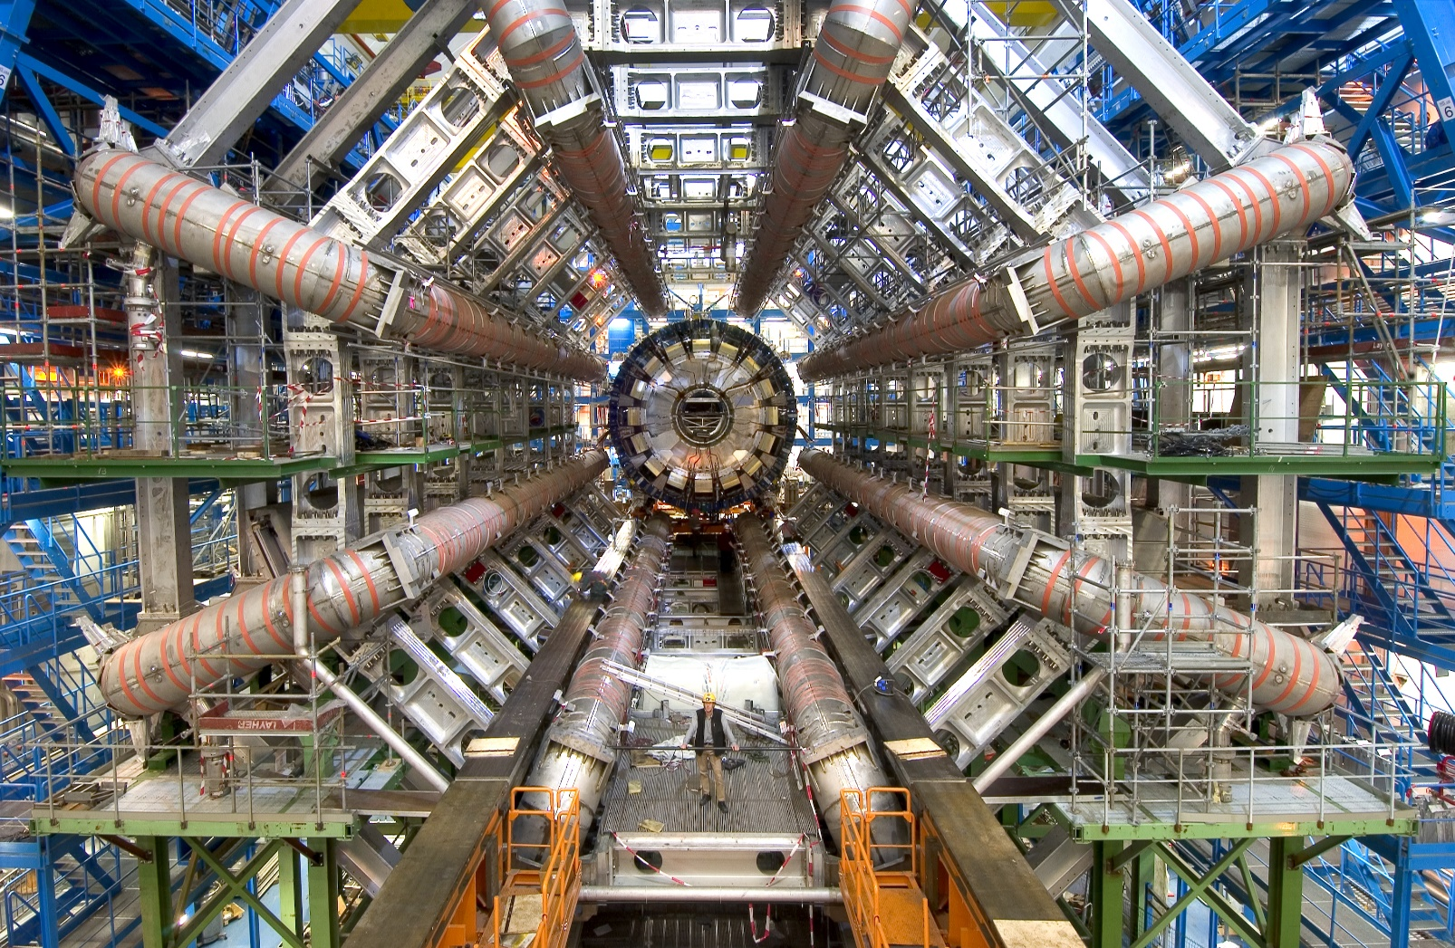
Analysing Events with W and Z Bosons
James Cummins & Dominic Williamson

Slide 2
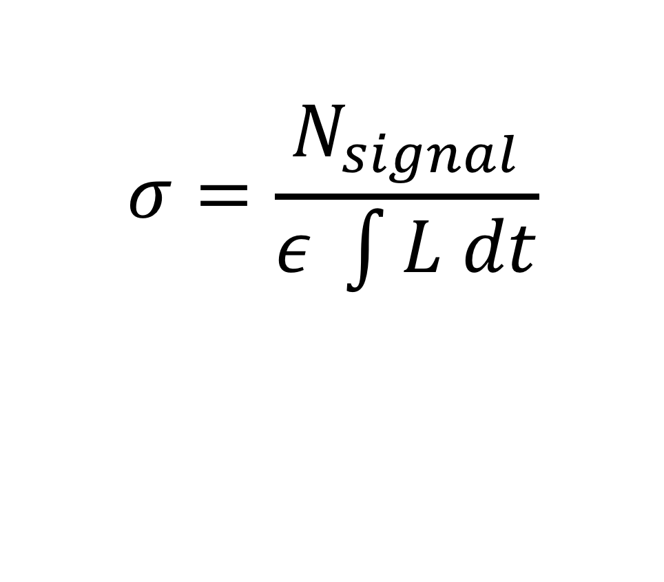
Cross Sections
$$σ=\frac{N_{signal}}{ε \int{L dt}}$$

Slide 3
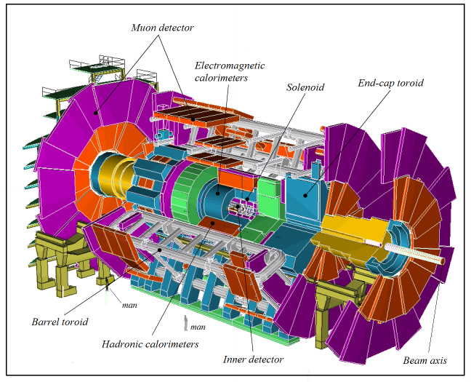
The ATLAS Detector

Slide 4
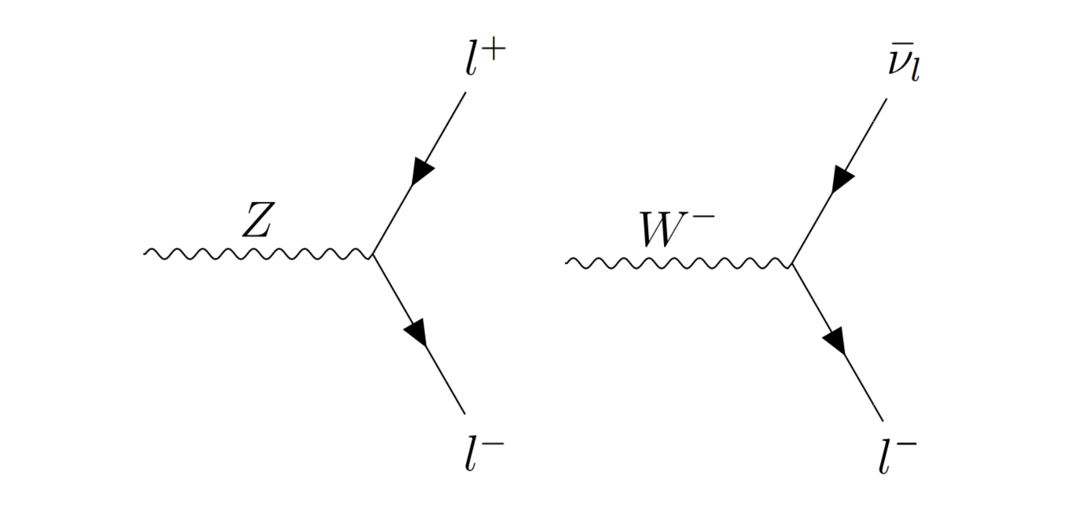
Cross Sections

Slide 5
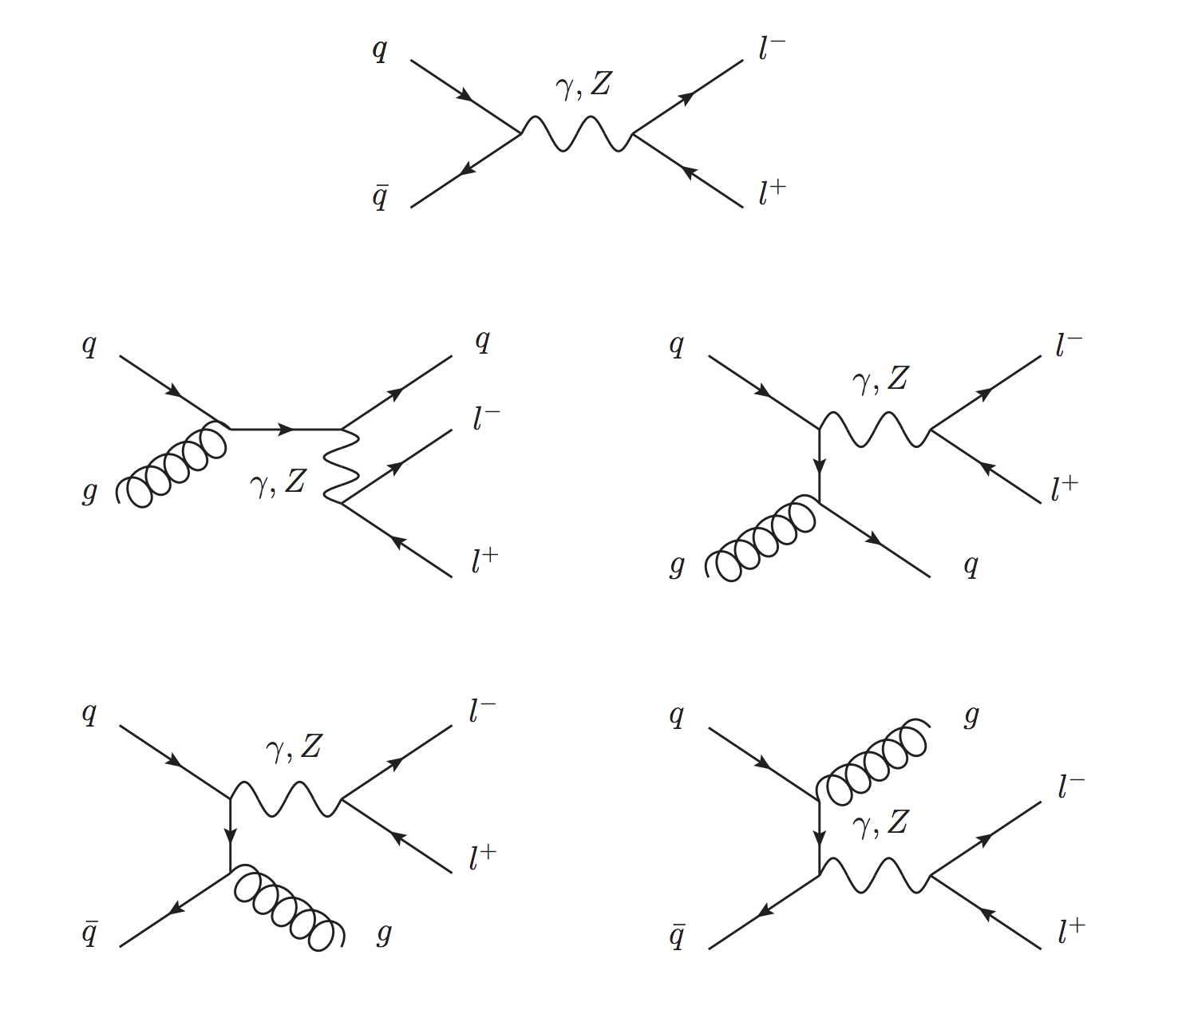
Examples of Drell-Yan Lepton Pair Production
Z Boson Background Processes

Slide 6
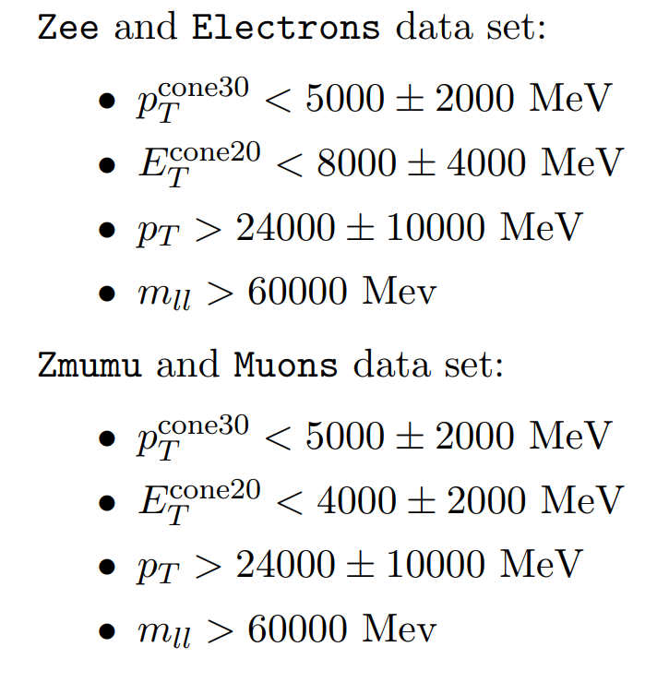
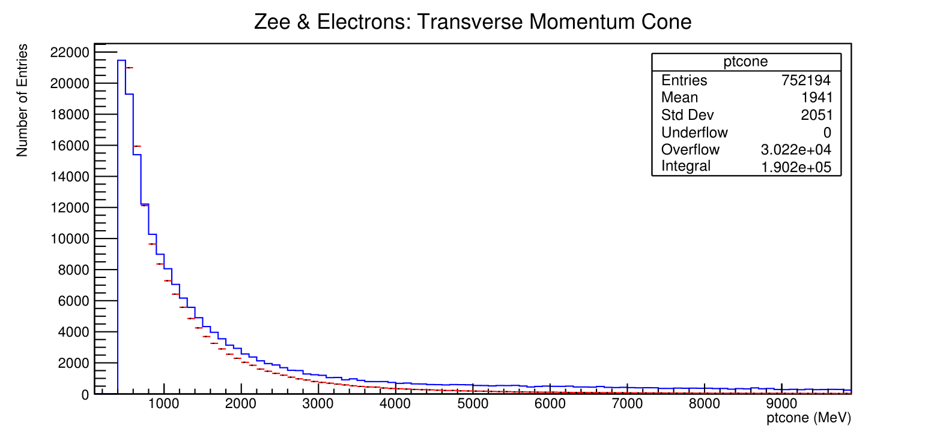
Z->ee Selection Criteria (Cuts)
MC data
ATLAS data

Slide 7
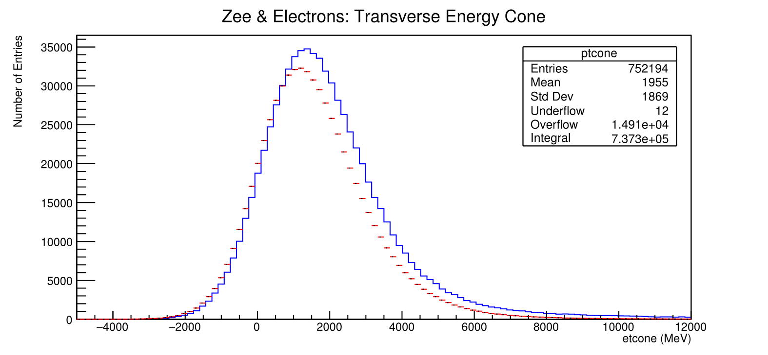
Z->ee Selection Criteria (Cuts)
MC data
ATLAS data

Slide 8
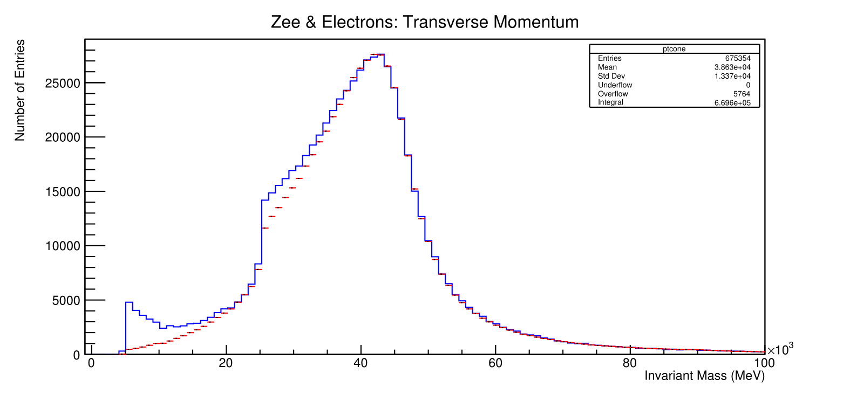
Z->ee Selection Criteria (Cuts)
MC data
ATLAS data

Slide 9
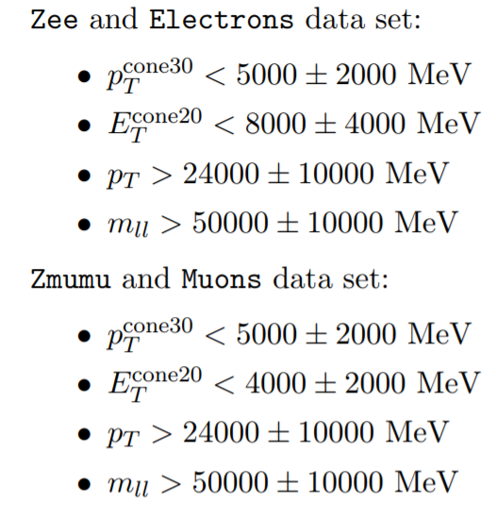
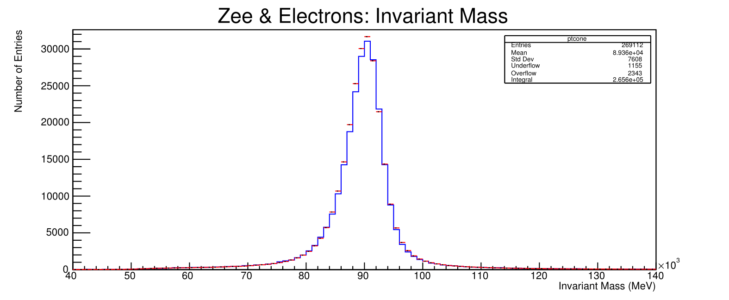
Z->ee Selection Criteria (Cuts)
MC data
MC data
ATLAS data
ATLAS data

Slide 10
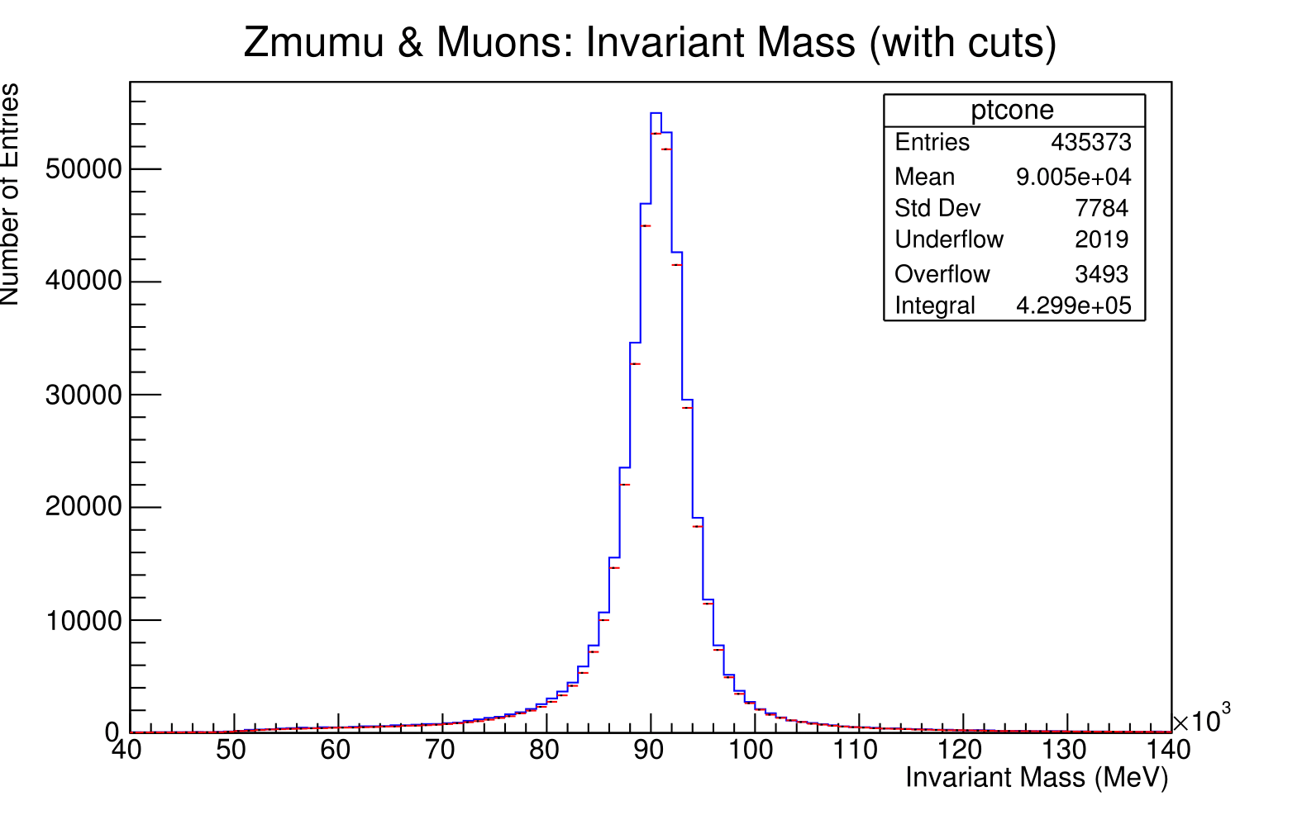
Z->mumu Selection Criteria (Cuts)
(See backup slides for the individual
Z->mumu plots)
MC data
ATLAS data

Slide 12
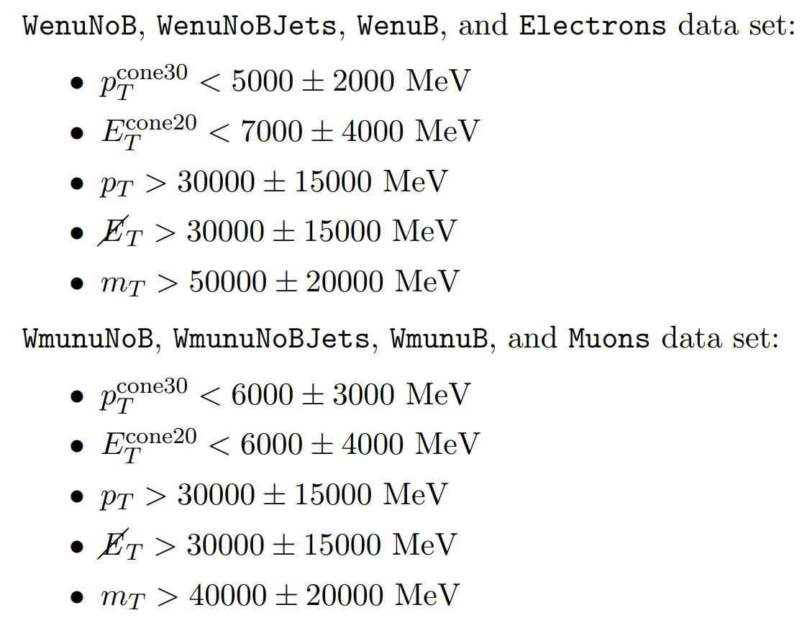
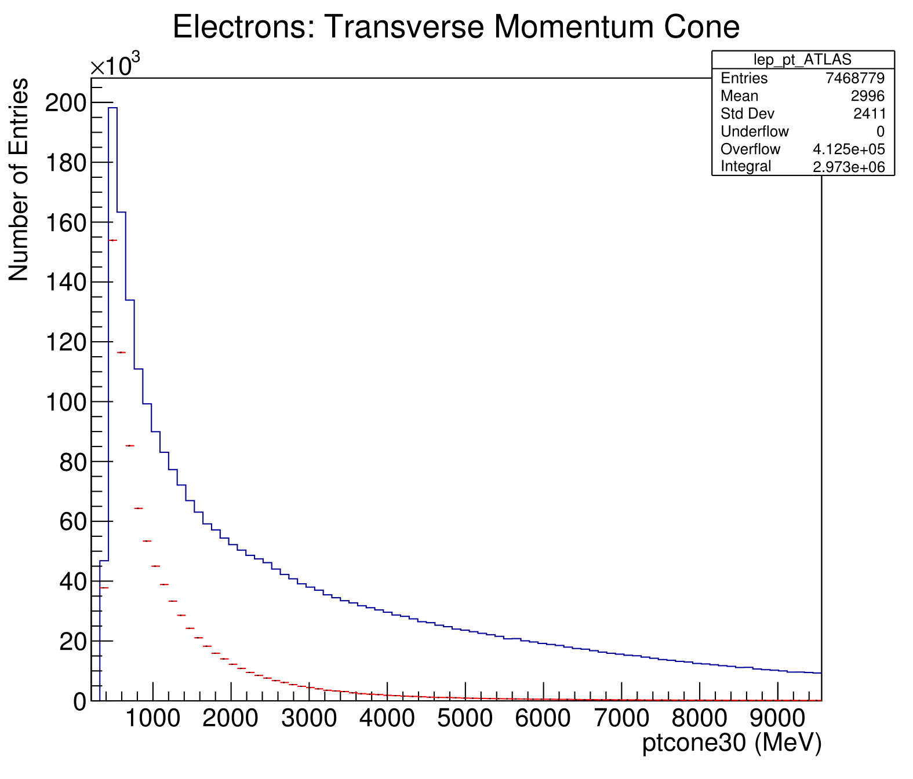
W->enu Selection Criteria (Cuts)
MC data
ATLAS data

Slide 13
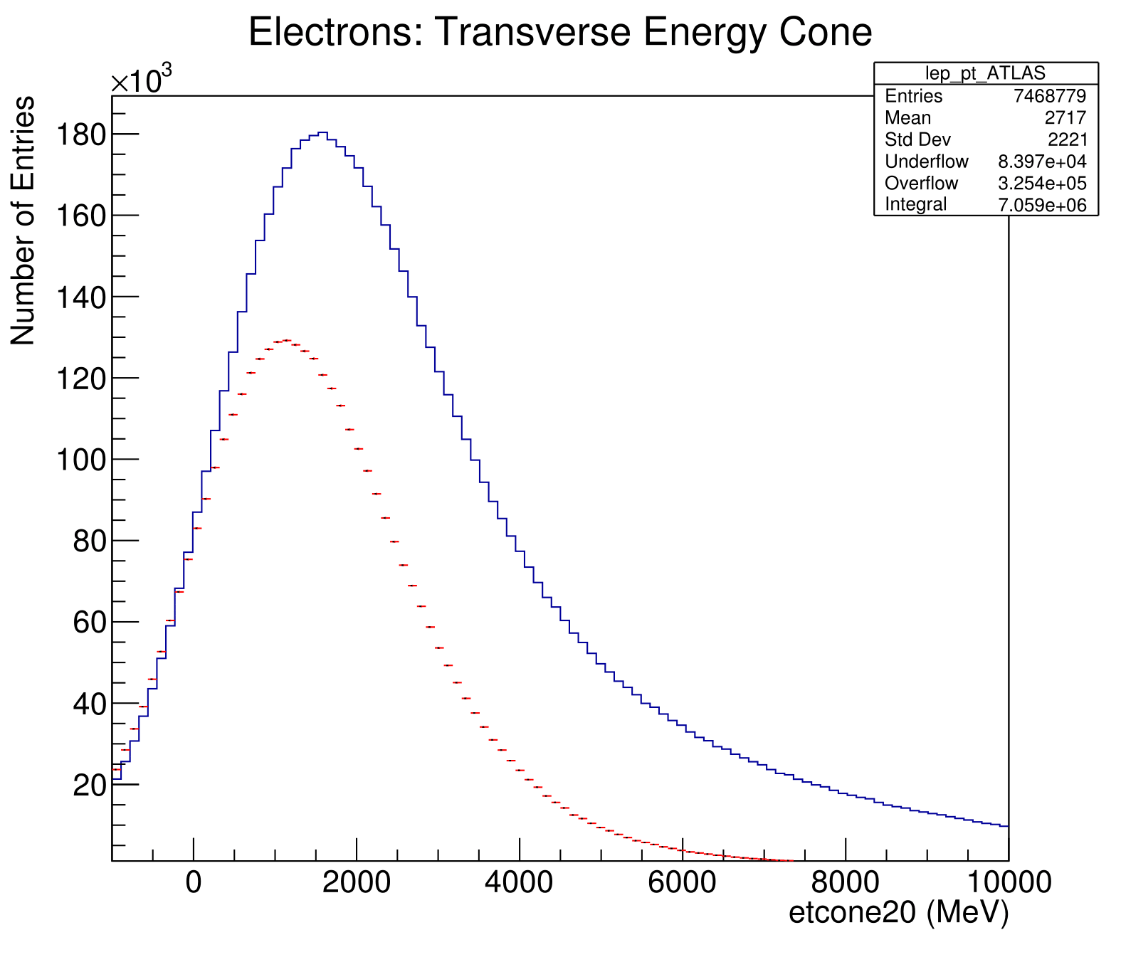
W->enu Selection Criteria (Cuts)
MC data
ATLAS data

Slide 14
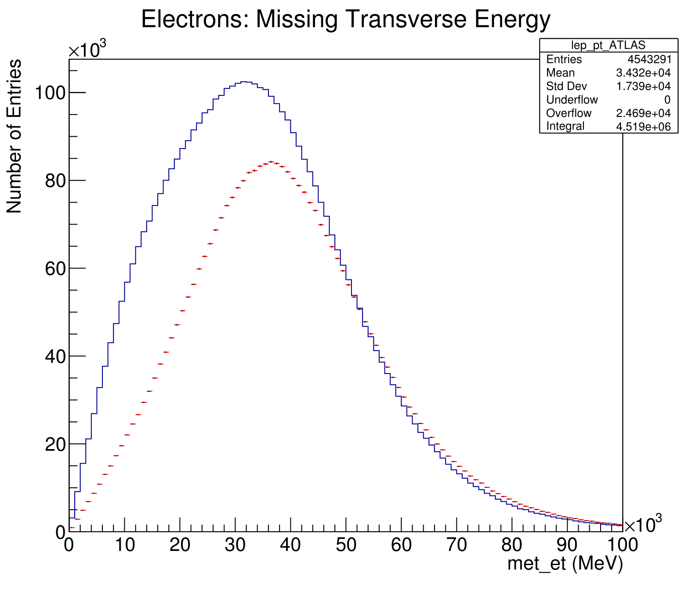
W->enu Selection Criteria (Cuts)
MC data
ATLAS data

Slide 15
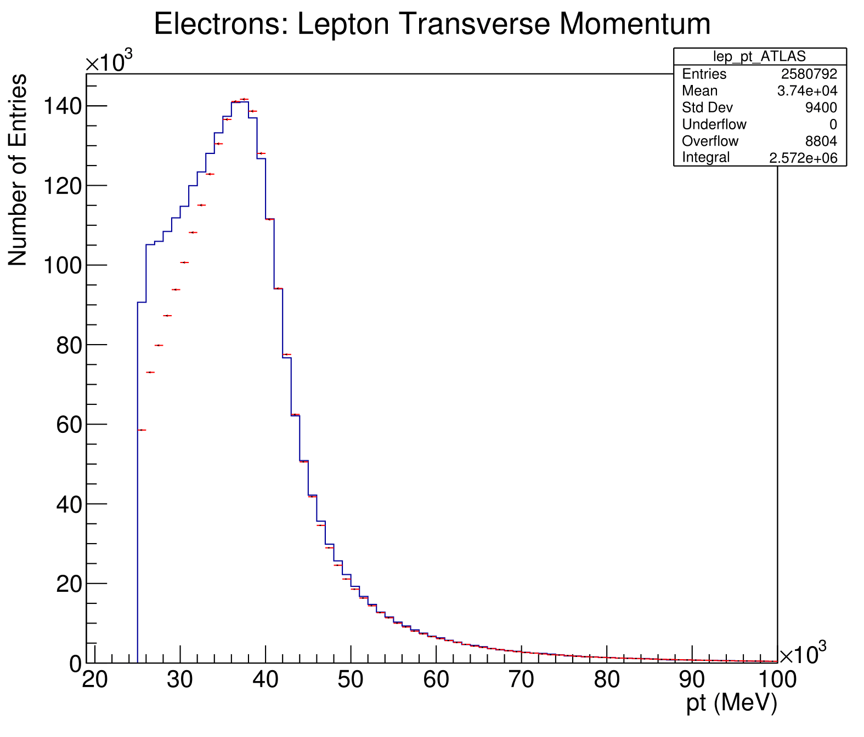
W->enu Selection Criteria (Cuts)
MC data
ATLAS data

Slide 16
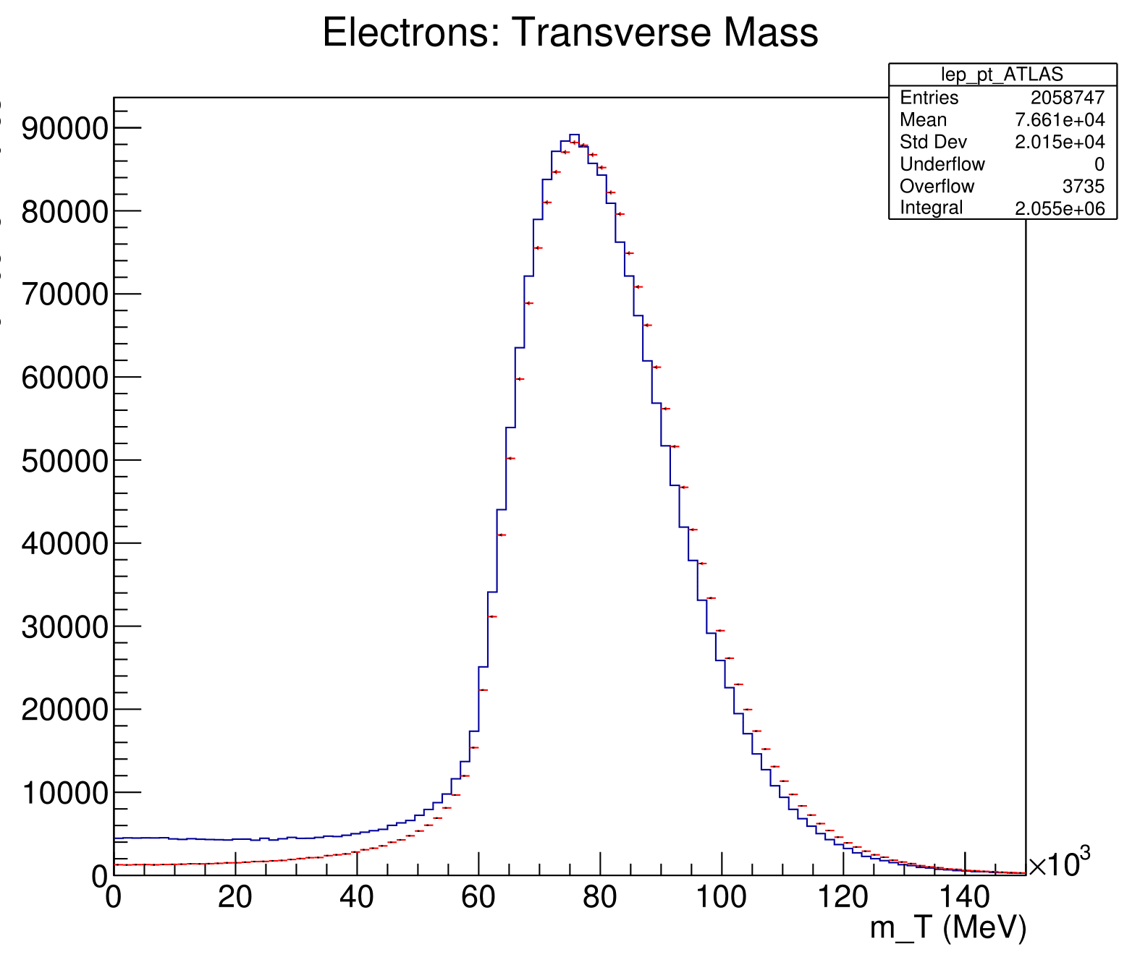
W->enu Selection Criteria (Cuts)
MC data
ATLAS data

Slide 17
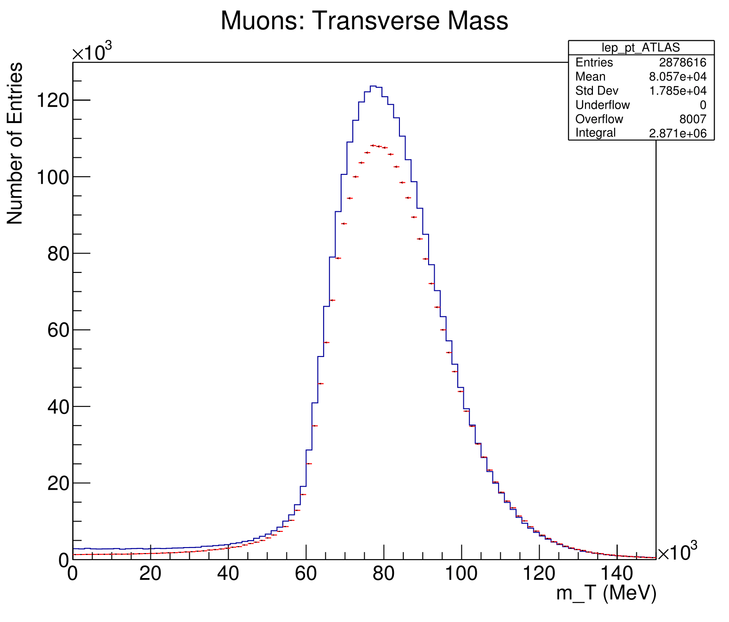
W->munu Selection Criteria (Cuts)
MC data
ATLAS data
(See backup slides for the individual W->munu plots)

Slide 18
Background Estimation
$$N_{signal}=N_{selected}−N_{background}$$
Electroweak (EW) background events determined from MC simulations
QCD background events need to be calculated too
Negligible for Z boson data but not for W boson data
QCD MC simulations cannot be produced due to large QCD cross section
Instead, data-driven methods are used
These are the ABCD method, and the fit method
Notes:
N_background for Z boson is sum of MC background events
As QCD background is assumed to be zero
QCD background in W boson events is not negligible
But MC processes cannot be simulated due to large QCD cross section
Therefore data-driven methods are used
These are the ABCD method, and the fit method

Slide 19
ABCD Method
High P_{T} Cone
Background
C
Control
B
Low P_{T} Cone
Control
D
Signal
A
Low M_{T}
High M_{T}

Slide 20
Fit Method
Plot all ATLAS data and all MC data (including EW background)
The difference between the two is the QCD background
Plot ATLAS data with the transverse mass cut inverted
This is a template of the QCD background
Scale the template of the QCD background and the MC data together to fit the ATLAS data
The scale factor used for the QCD background is then multiplied by the integral for the QCD background, providing an estimate for the true QCD background in the ATLAS data

Slide 21
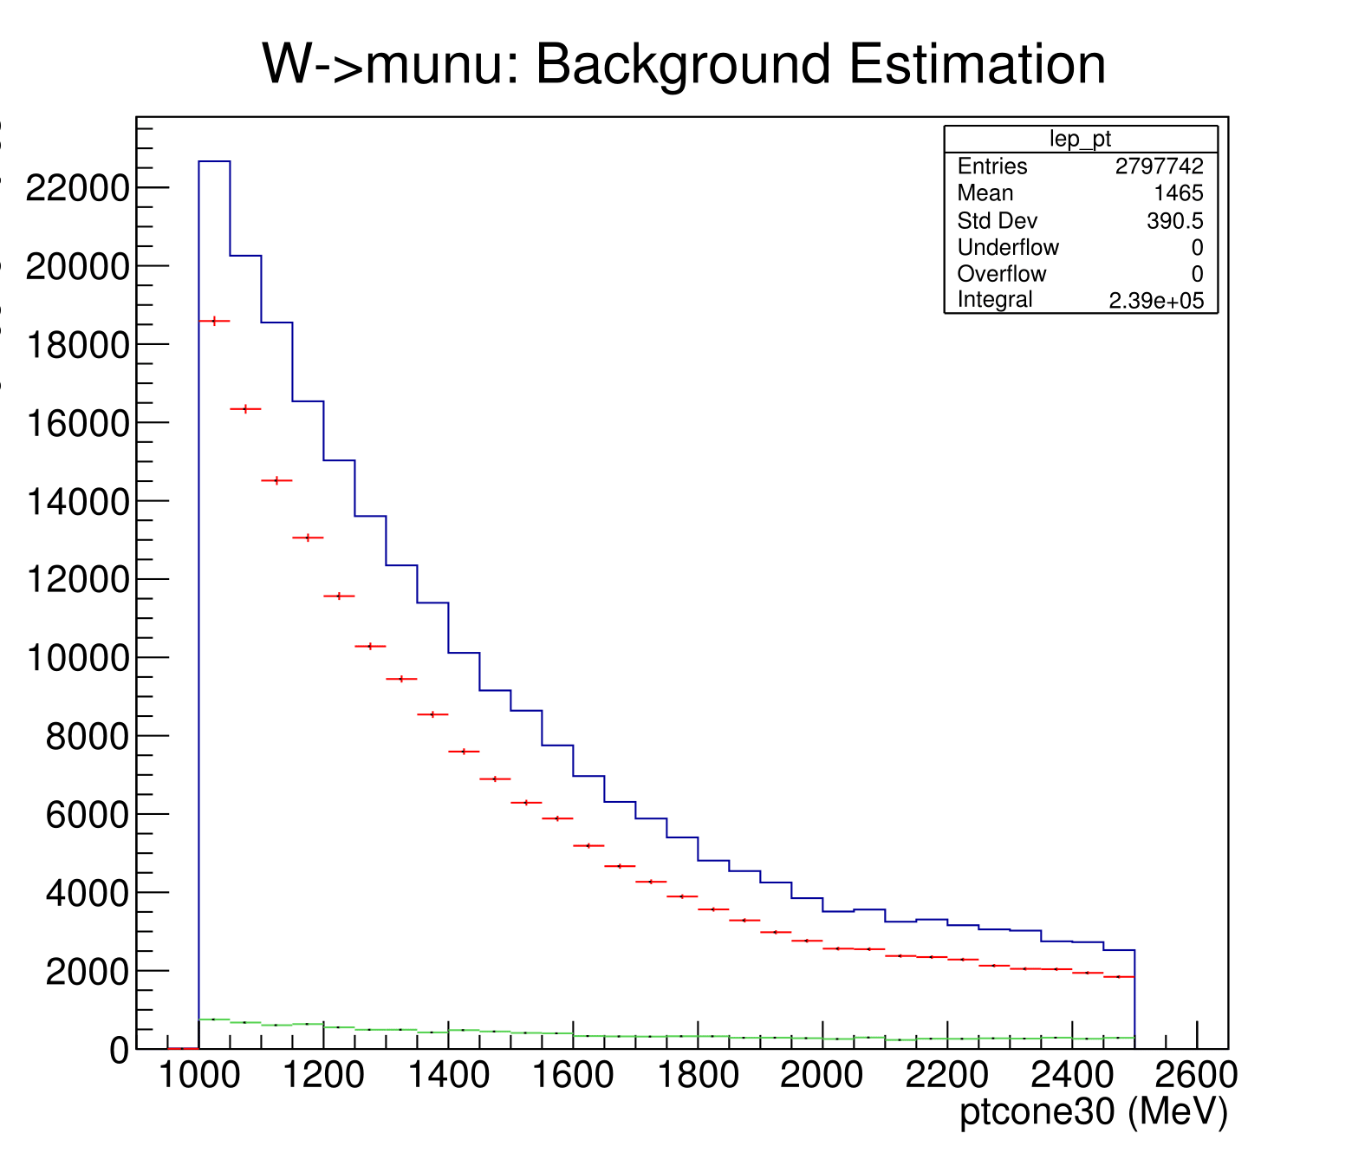
Fit Method W->munu channel
MC signal + EW background
ATLAS data
QCD background

Slide 22
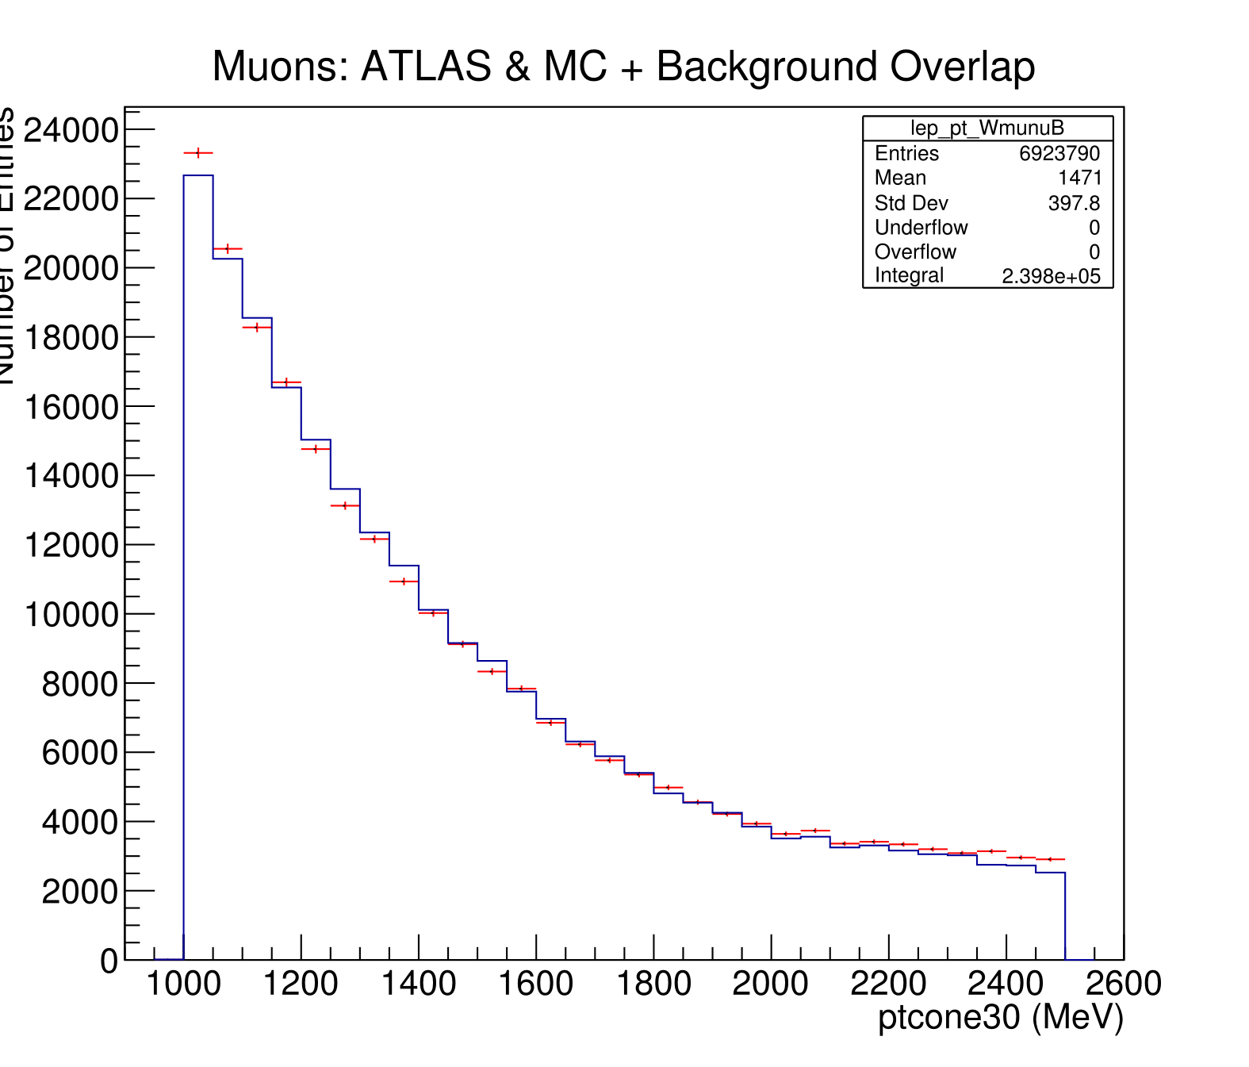
Fit Method W->munu channel
MC signal + all background
ATLAS data

Slide 23
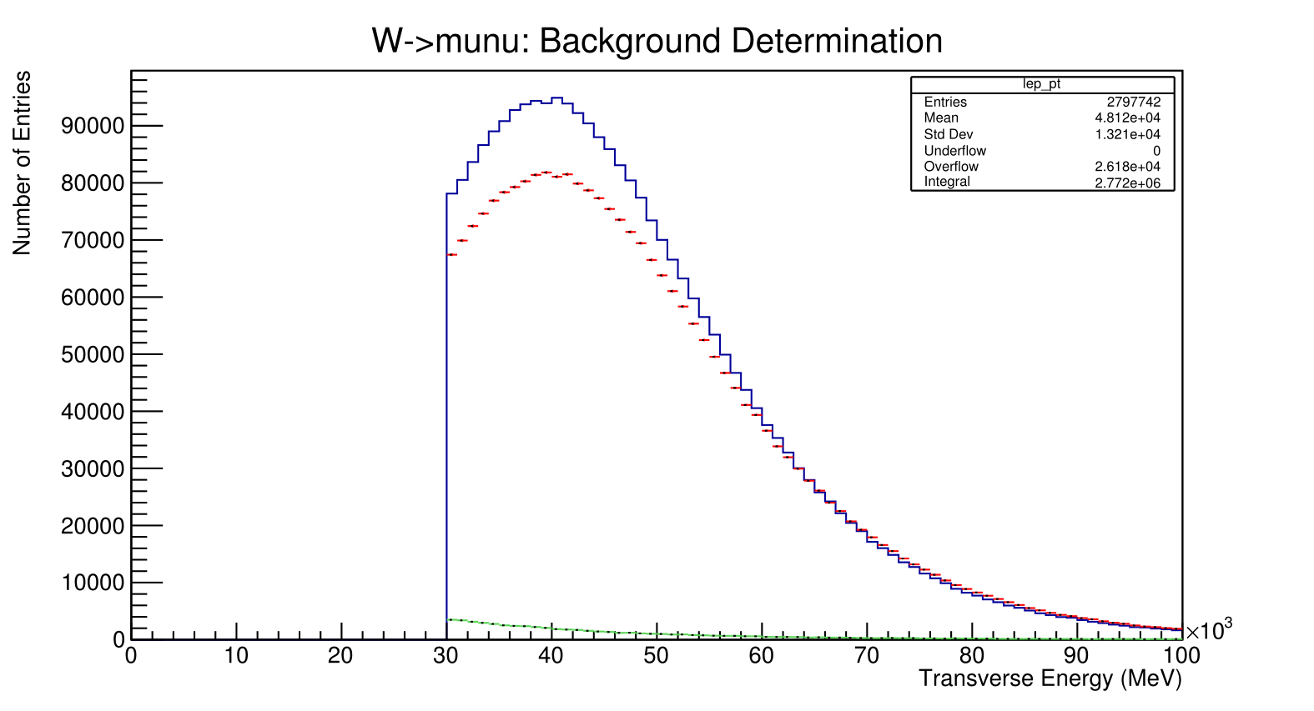
Fit Method W->munu channel
MC signal + EW background
ATLAS data
QCD background

Slide 24
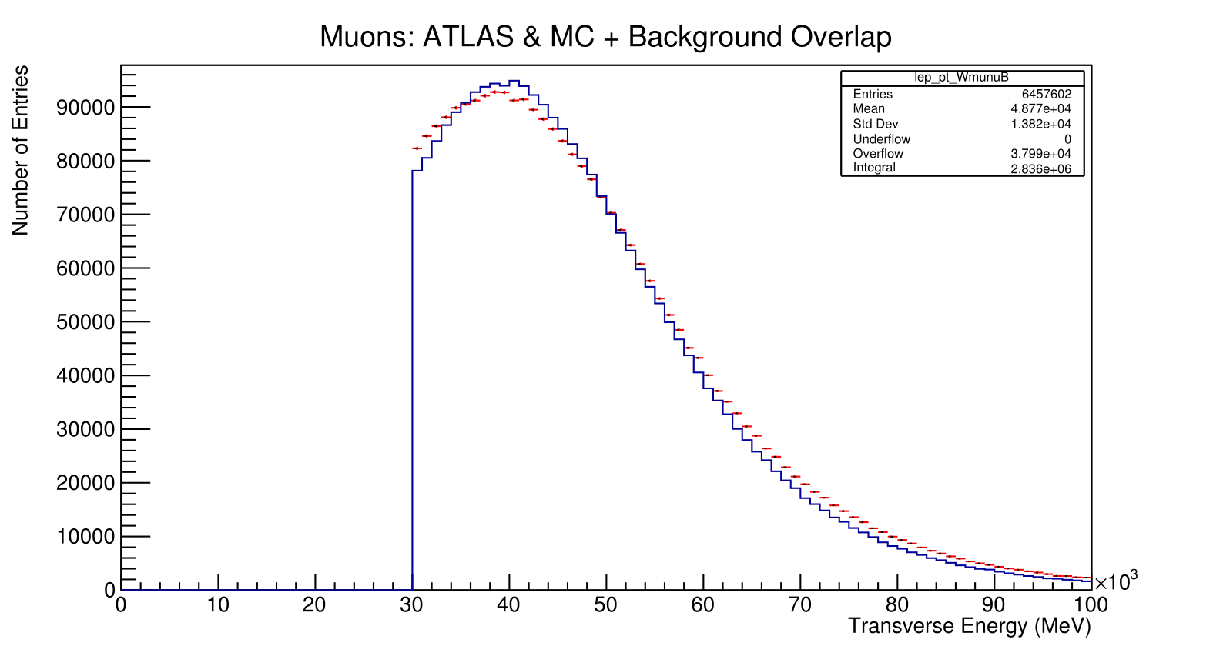
Fit Method W->munu channel
MC signal + all background
ATLAS data

Slide 25
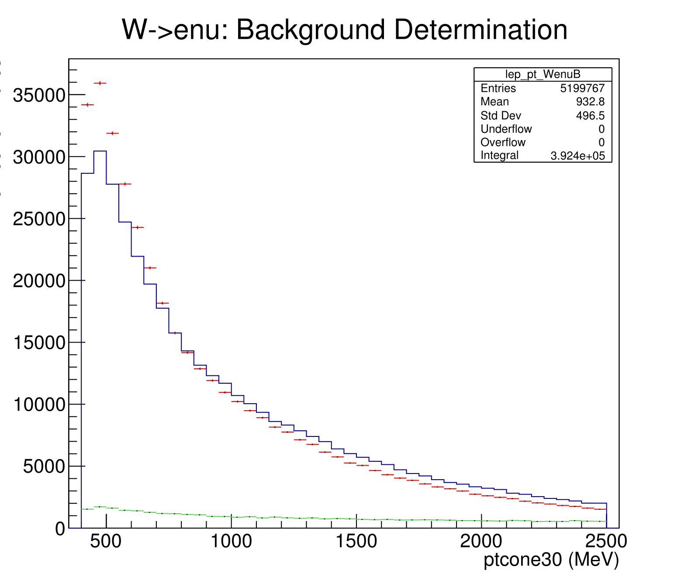
Fit Method W->enu channel
MC signal + EW background
ATLAS data
QCD background

Slide 26
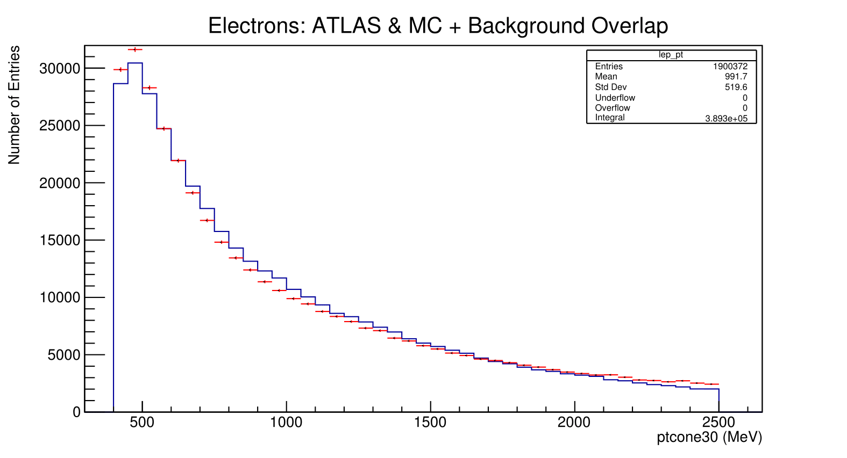
Fit Method W->enu channel
MC signal + all background
ATLAS data

Slide 27
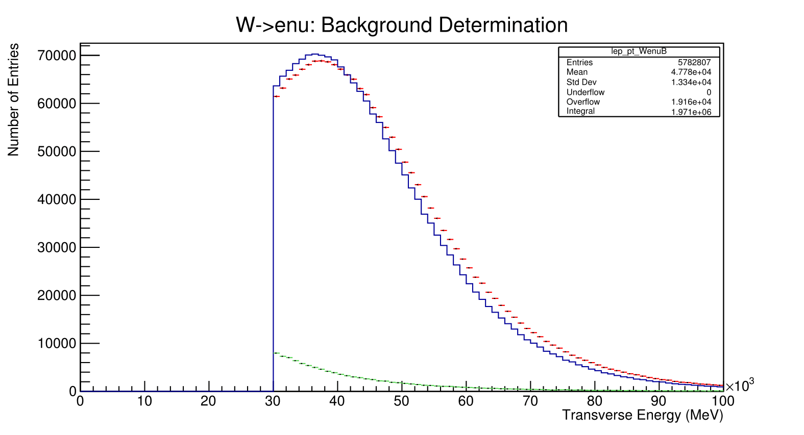
Fit Method W->enu channel
MC signal + EW background
ATLAS data
QCD background

Slide 28
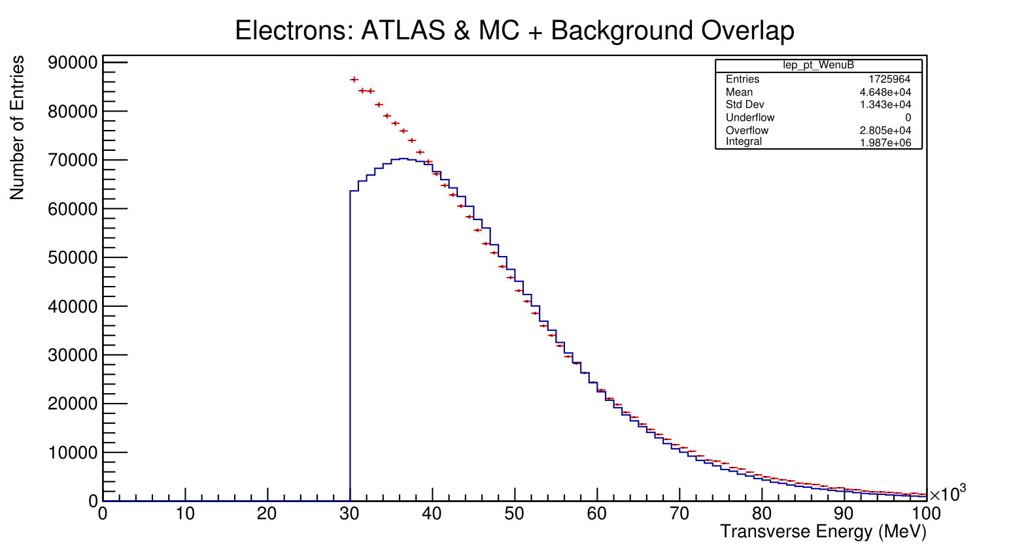
Fit Method W->enu channel
MC signal + all background
ATLAS data

Slide 29
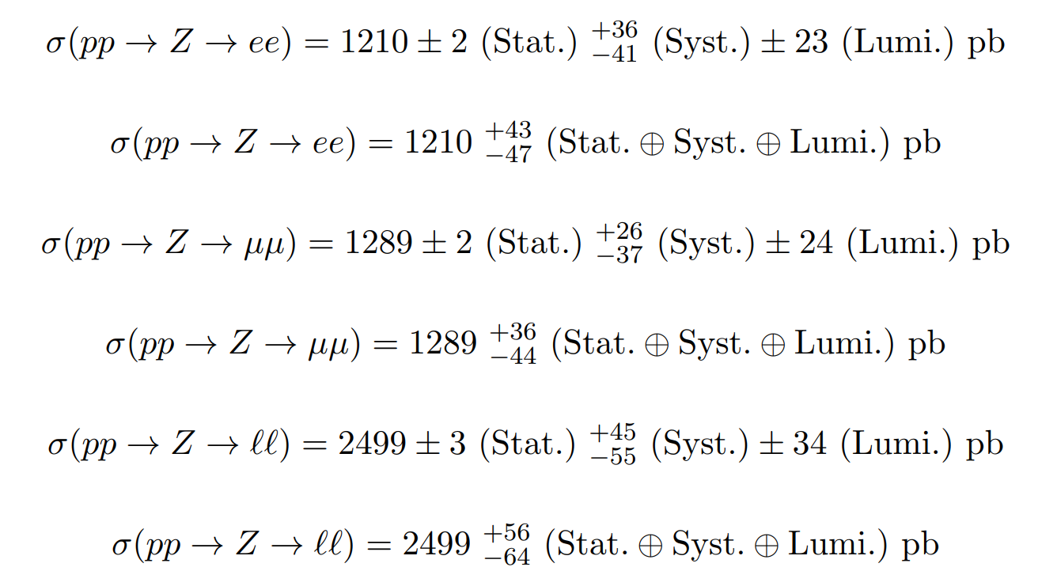
Z Boson Results

Slide 30
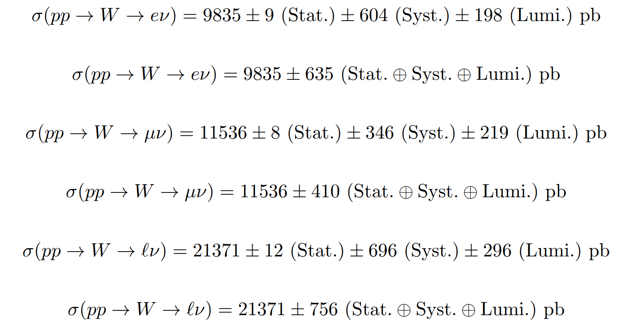
W Boson Results

Slide 31
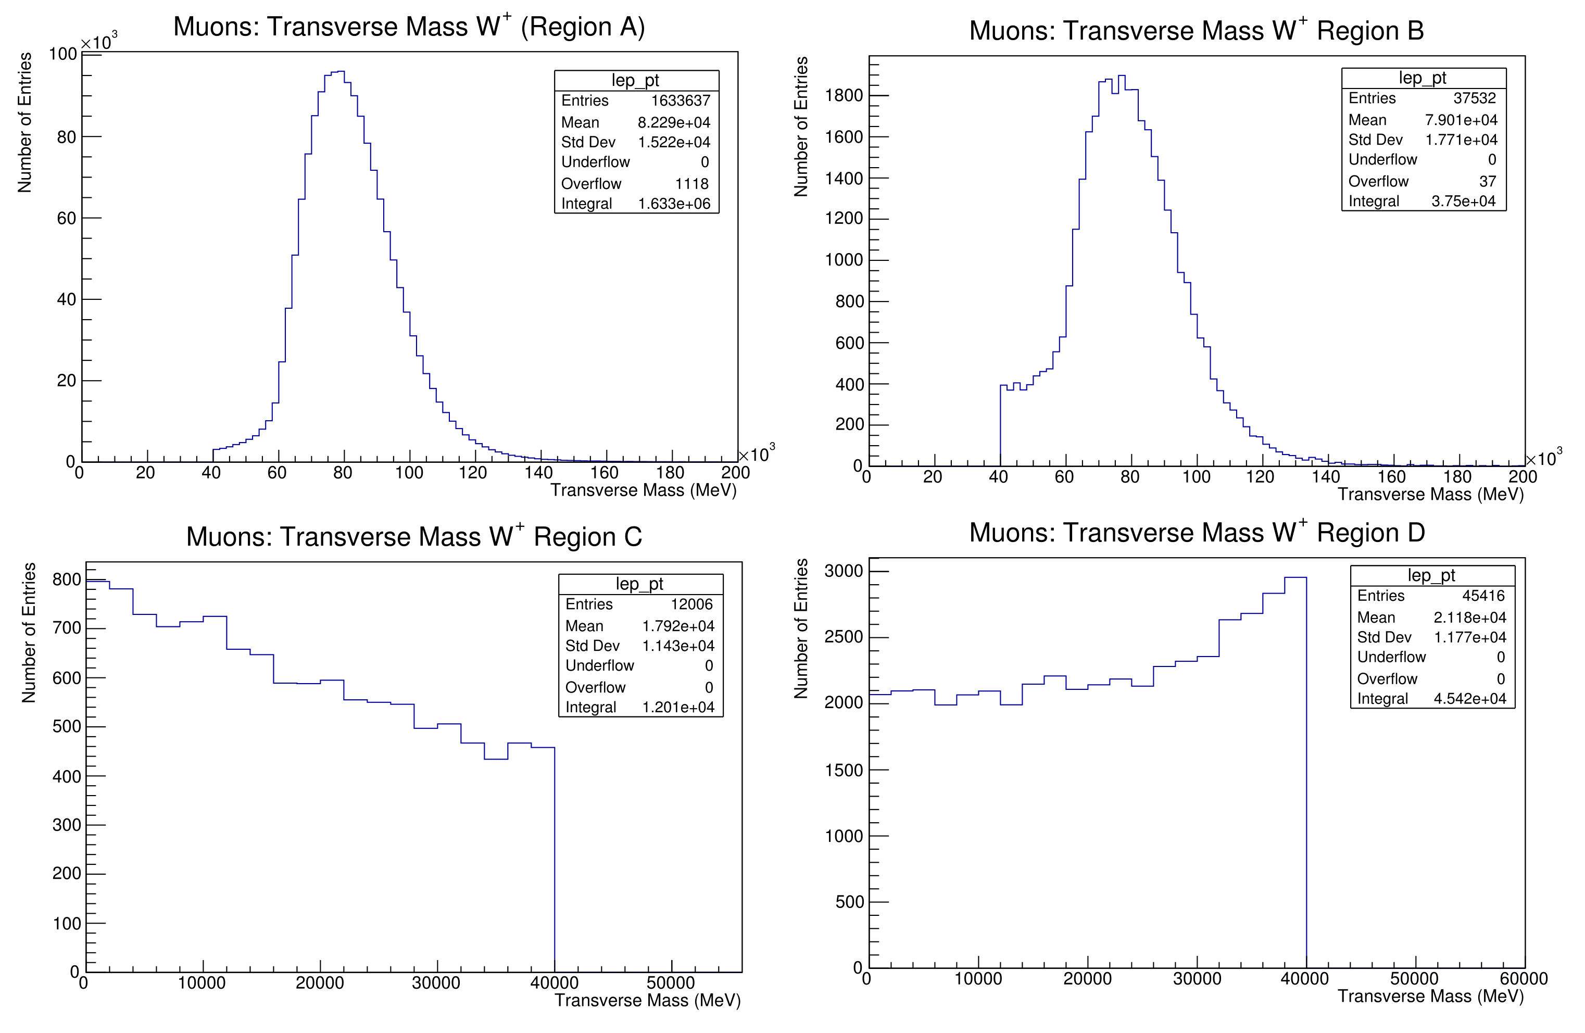
Extension: W Boson Asymmetry

Slide 32
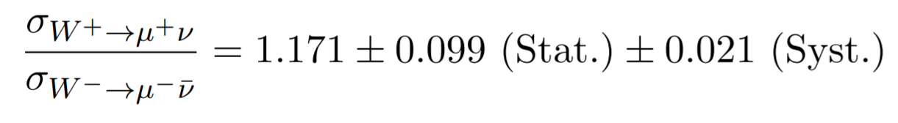
Extension: W Boson Asymmetry

Slide 33
Backup

Slide 34
Z->ee Selection Criteria (Cuts)

Slide 35
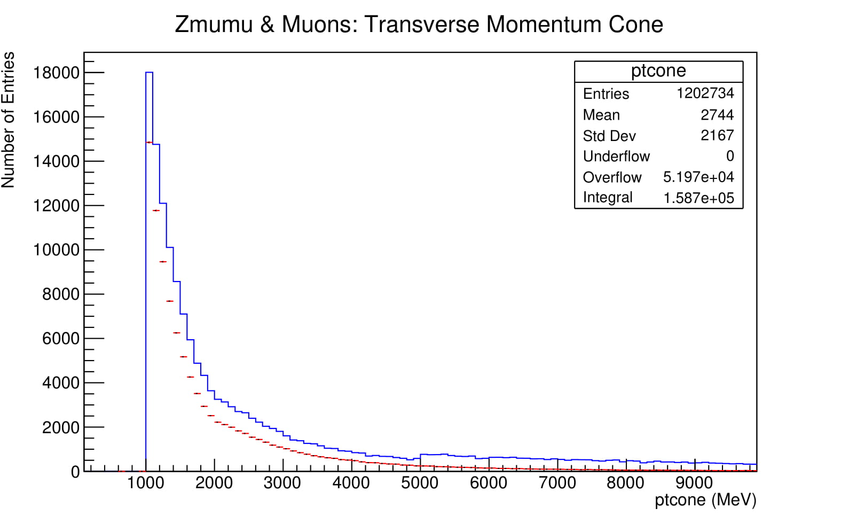
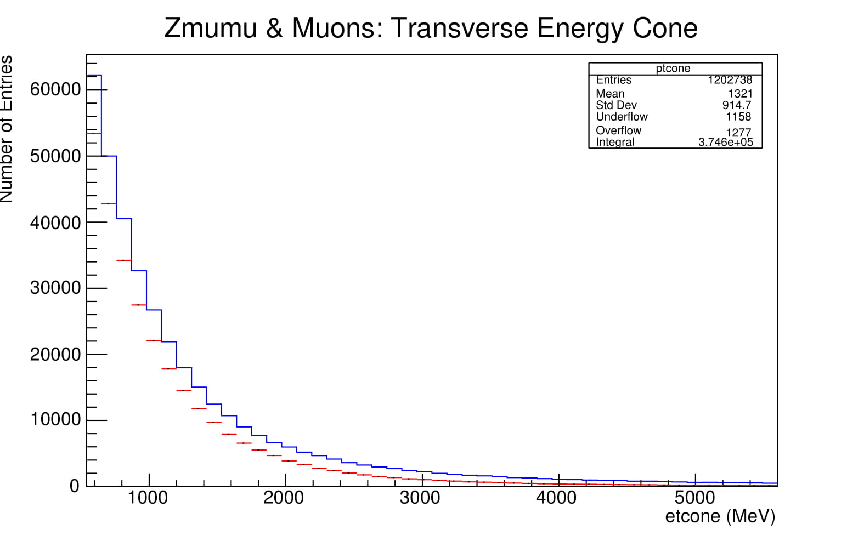
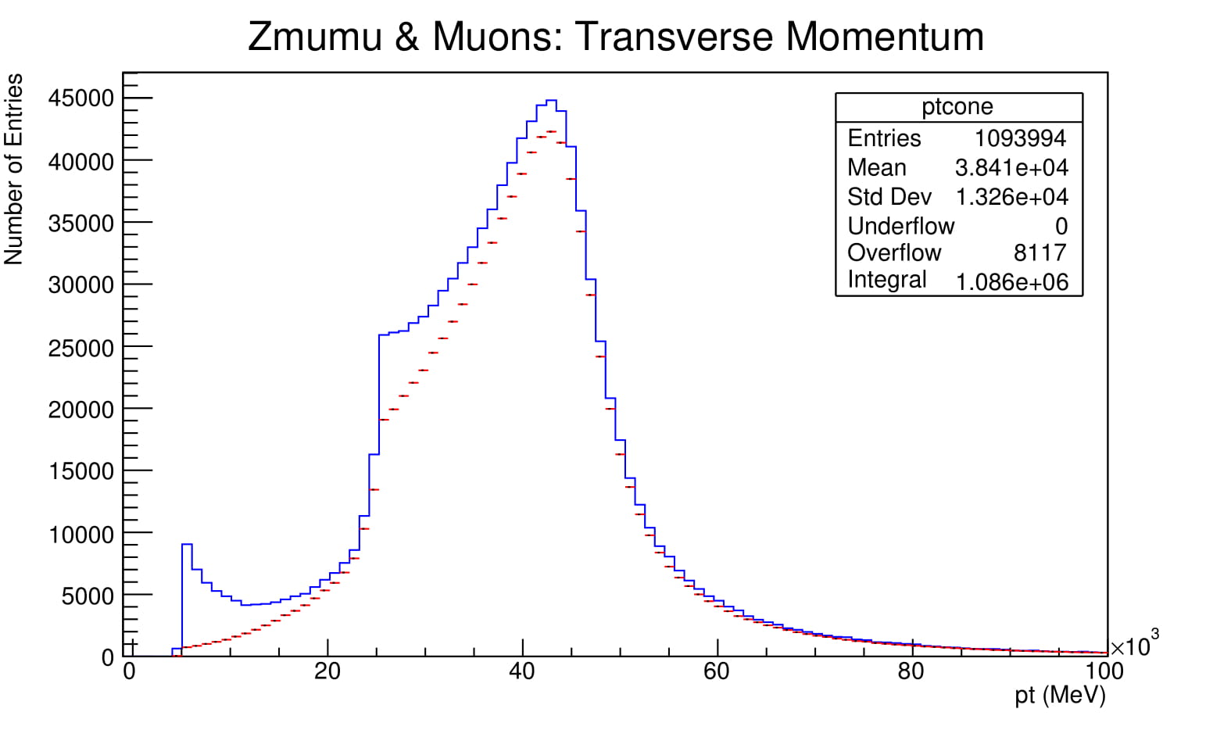
Z->mumu Selection Criteria (Cuts)

Slide 36
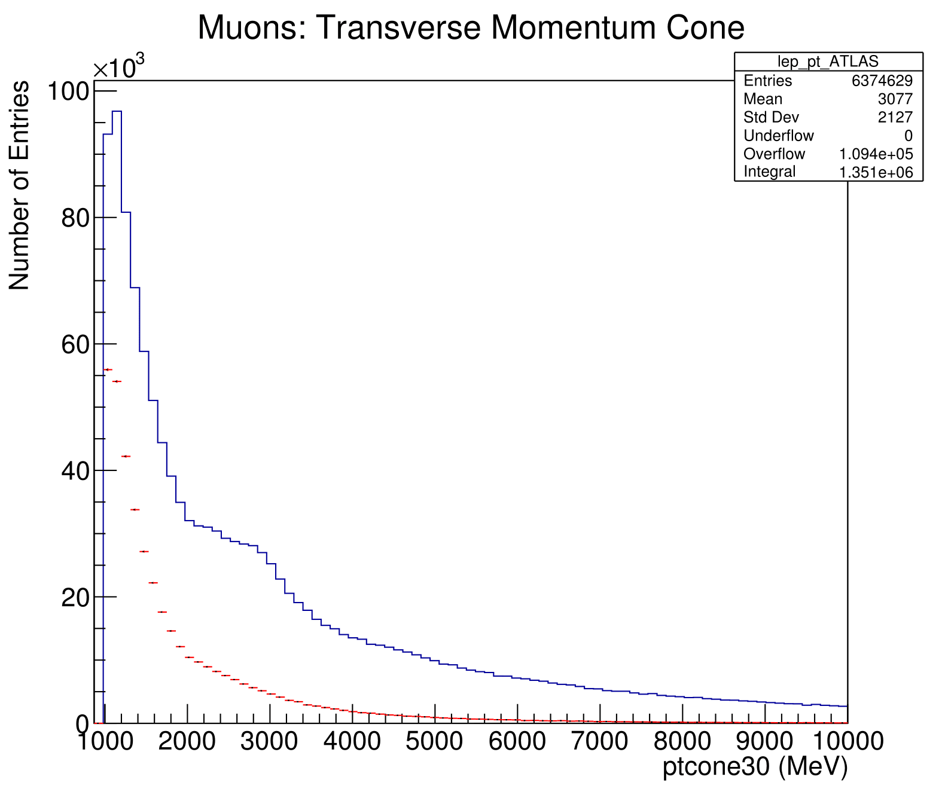
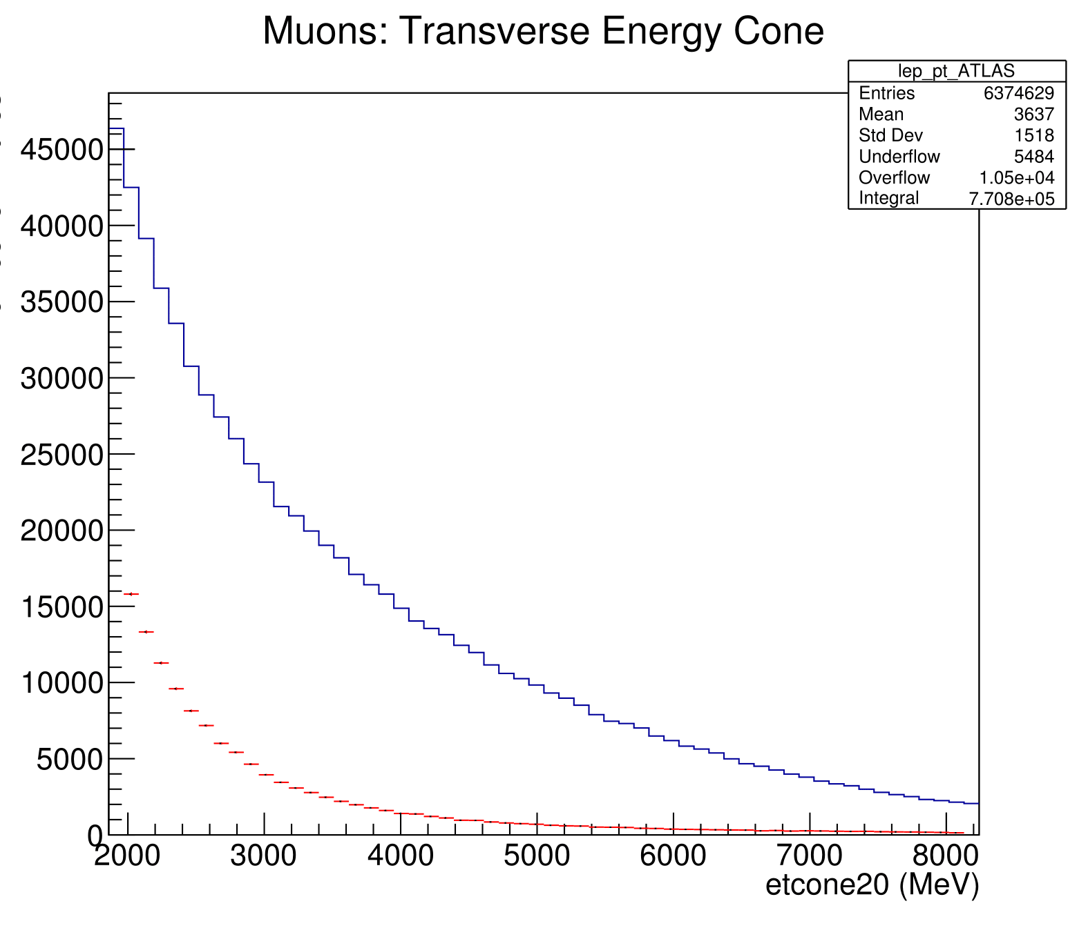
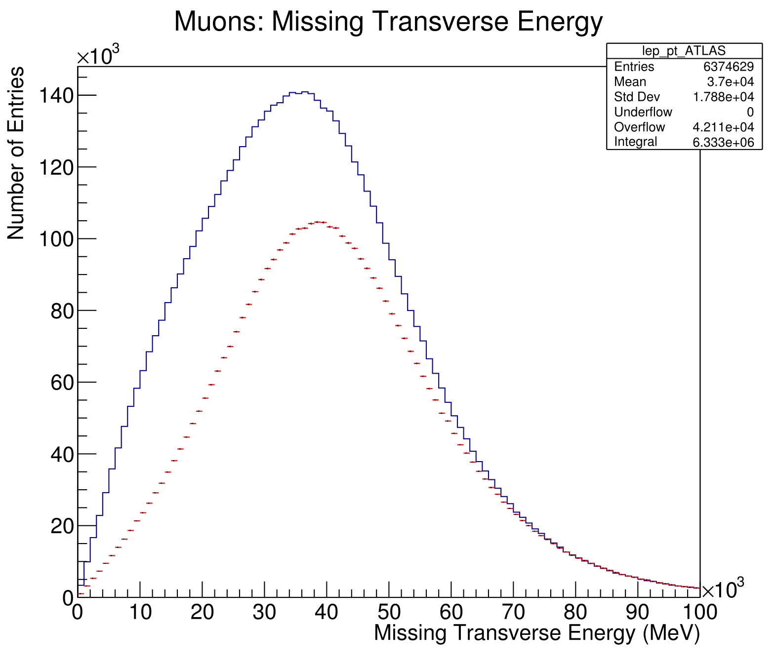
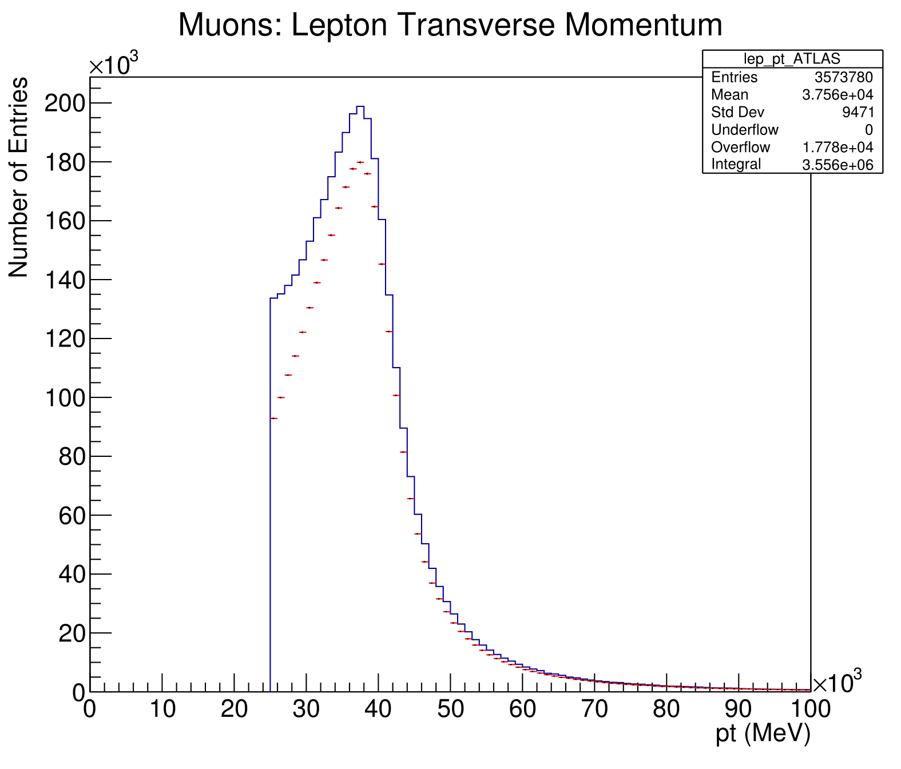
W->munu Selection Criteria (Cuts)

Slide 37
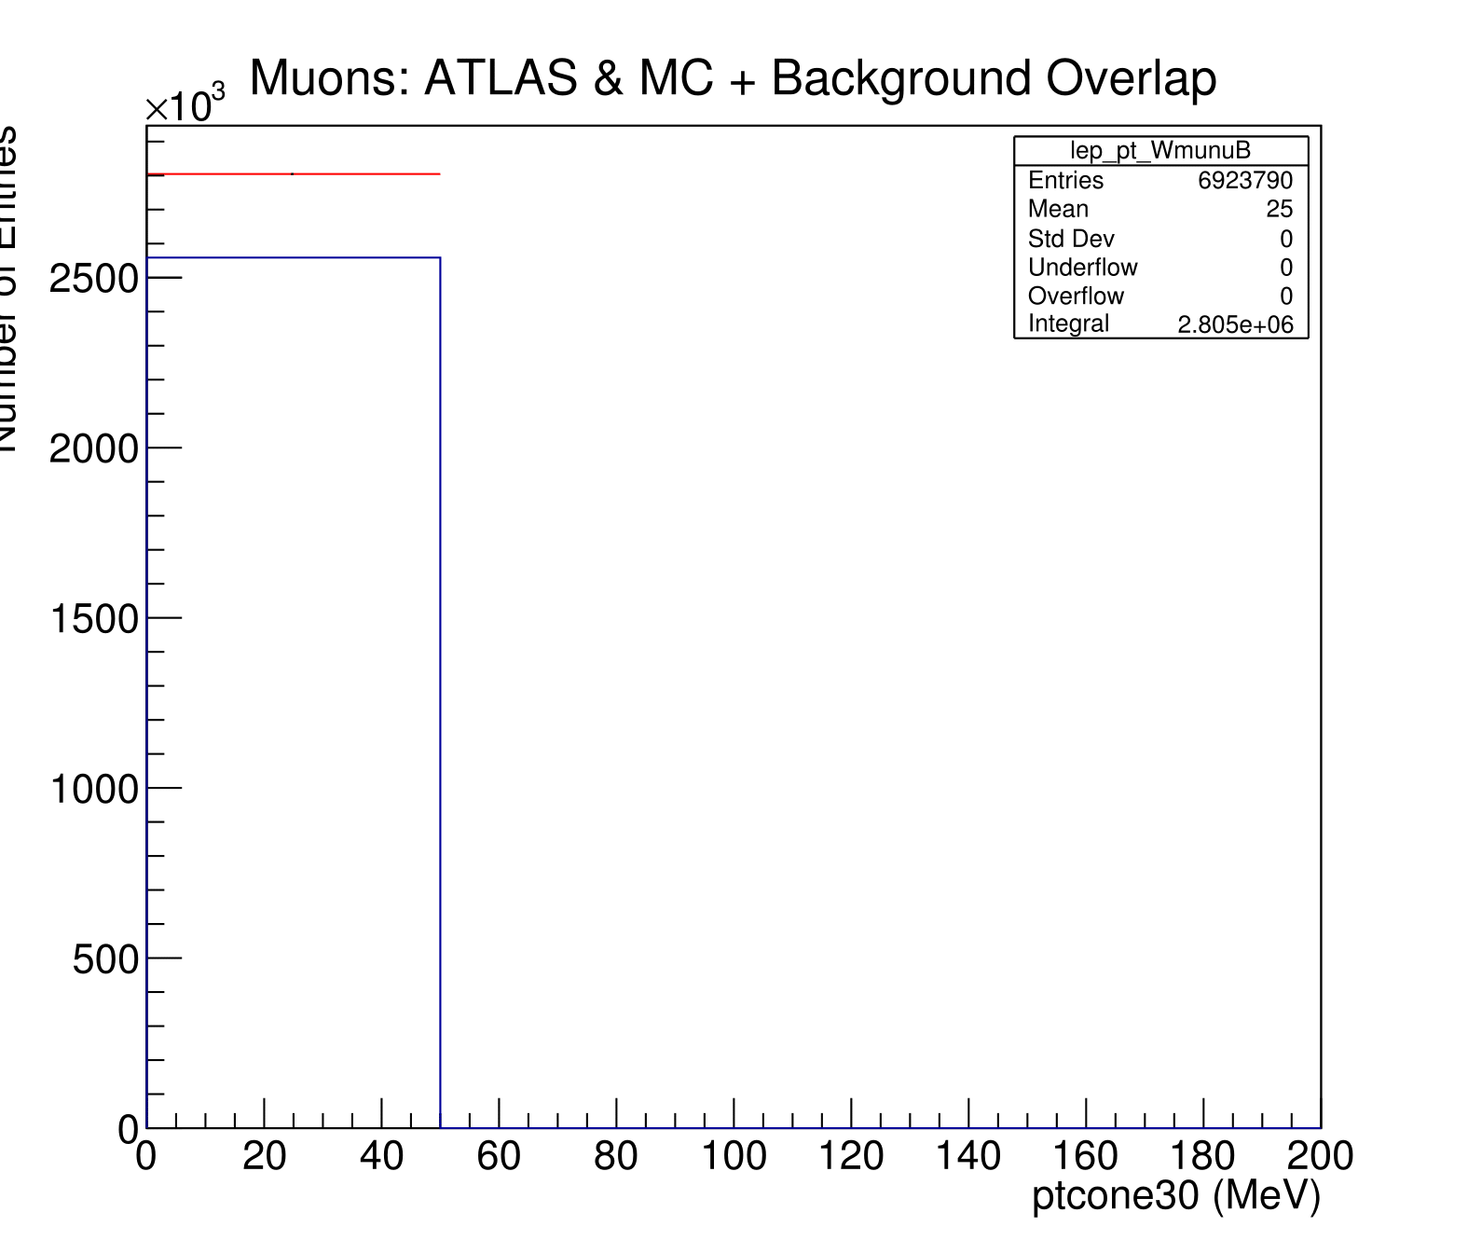
W->munu Background Zero Peak

Slide 38
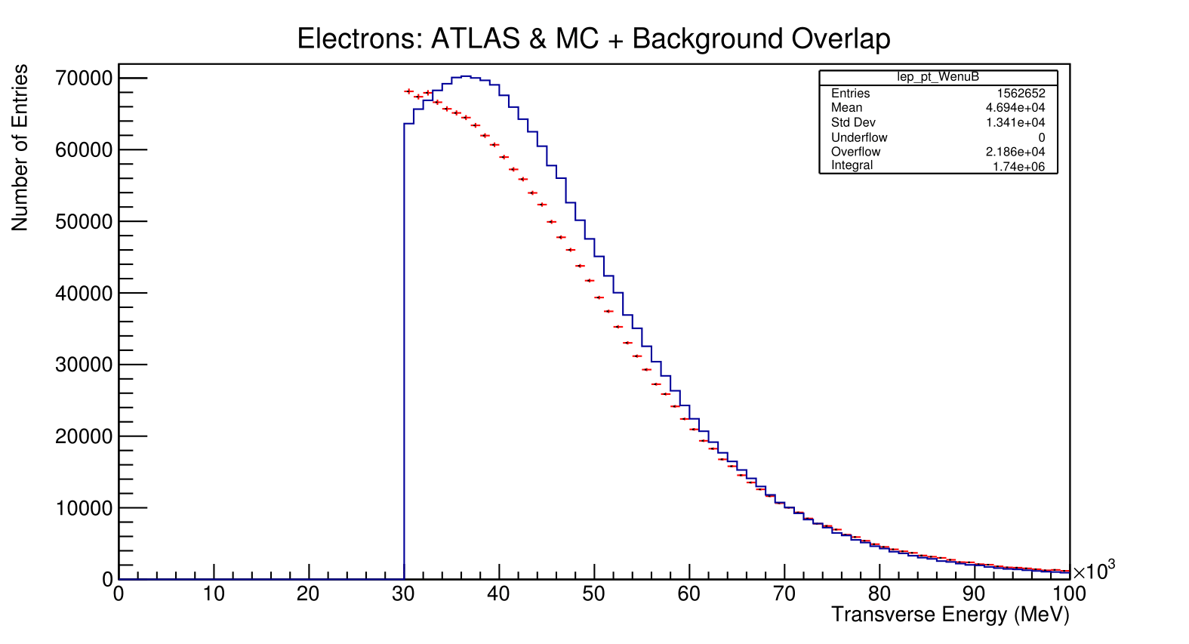
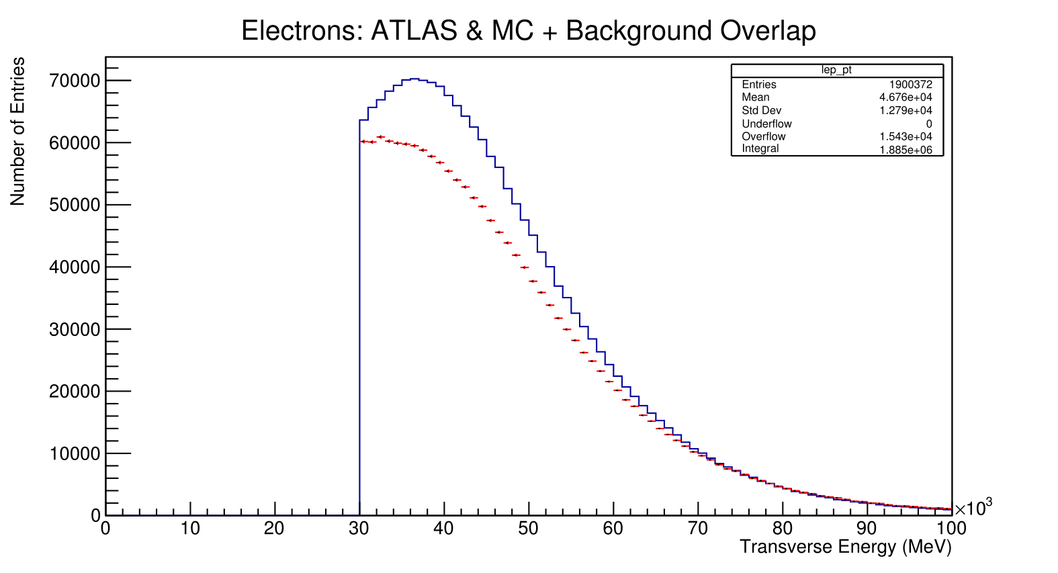
Fit Method W->enu channel

